Slide 1
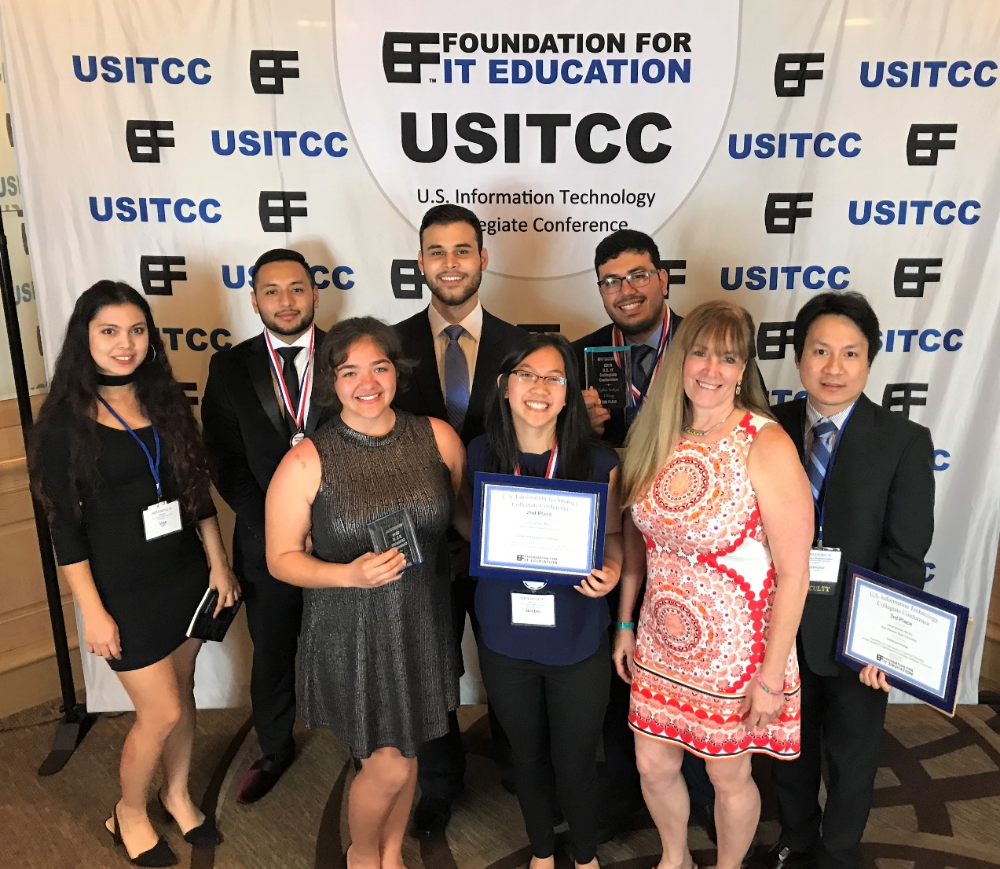
2019 USITCC Conference
MIS students: E. Martinez, F. Junay Lemus, G. Atkinson, J. Shirazi, N. Do, and U. KC Do & Shirazi won the 2nd place in the System Analysis and Design contest.
Do & Shirazi won the 3rd place in the Database Design contest.
Do & Junay Lemus won an Honorable Mention Award in the Business Analytics.
AITP Advisors: Dr. Warner & Dr. Wipawayangkool; Sponsors: COBA & Global Shop Solutions

